Slide 1
Introduction to DBMS
Dr. T. JOSHVA DEVADAS
Associate Professor Senior
SJT Annex- 103 F
Joshvadevadas.t@vit.ac.in

Slide 2

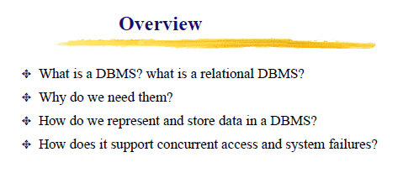

Slide 3


Slide 4


Slide 5
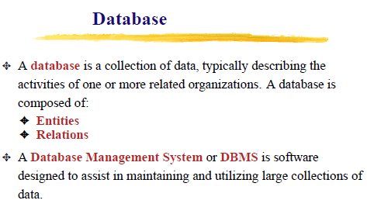

Slide 6
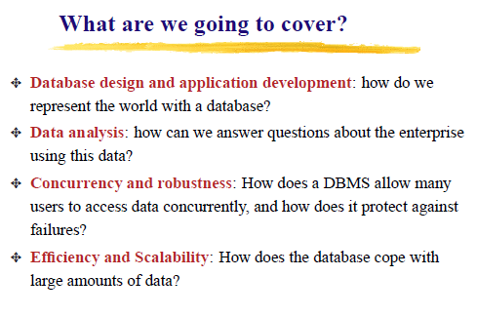

Slide 7
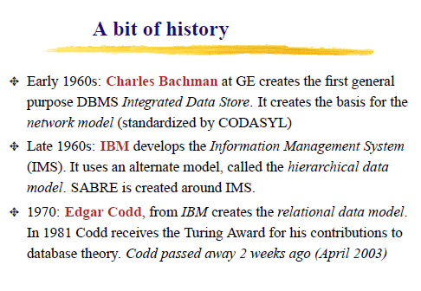

Slide 8
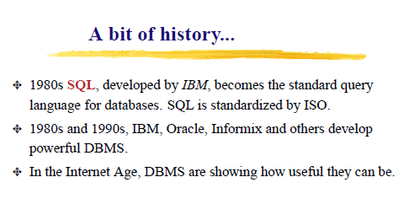

Slide 9


Slide 10
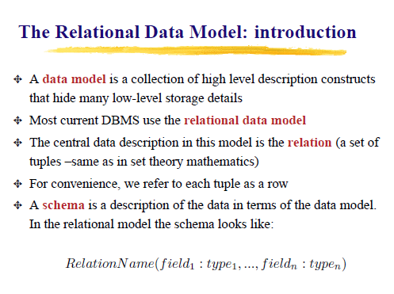

Slide 11
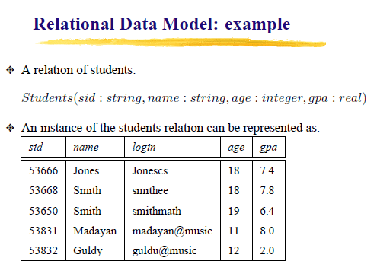

Slide 12
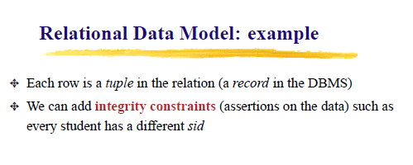

Slide 13
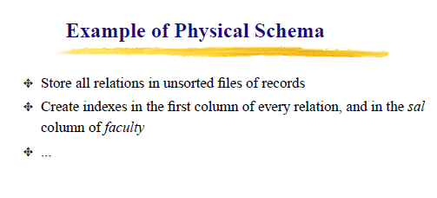
PHYSICAL SCHEMA
Physical schema is a term used in data management to describe how data is to be represented and stored (files, indices, et al.) in secondary storage using a particular database management system (DBMS) (e.g., Oracle RDBMS, Sybase SQL Server, etc.).

Slide 14
Conceptual schema
A conceptual schema is a high-level description of informational needs underlying the design of a database. It typically includes only the main concepts and the main relationships among them. Typically this is a first-cut model, with insufficient detail to build an actual database.

Slide 15
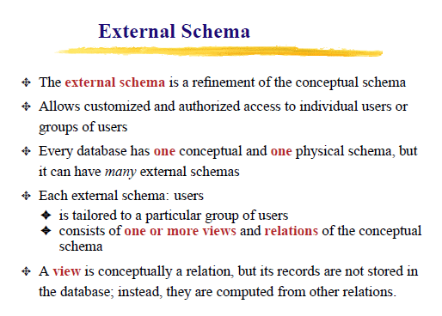


Slide 16
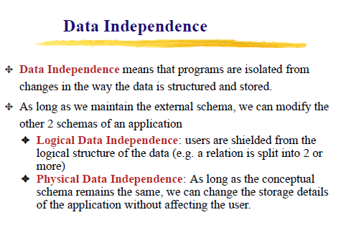

Slide 17


Slide 18
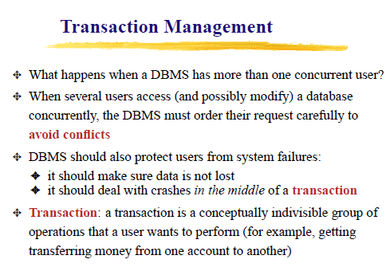

Slide 19
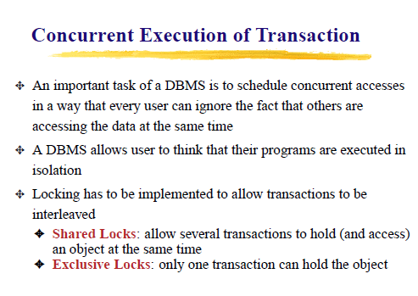

Slide 20


Slide 21
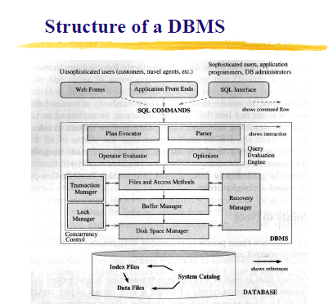

Slide 22
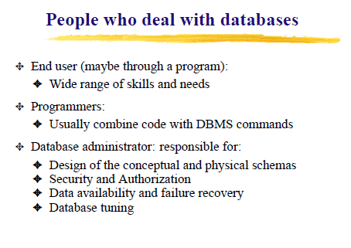

Slide 23


